Slide 1
Voice-Controlled Obstacle Avoiding Car
Presented By:
Mst. Saida Alam Mukti (23101003)
Md. Mohibur Rahman (23101006)
Md. Jubaer (23101008)
S. M. Asikuzzaman Abir (23101022)
Sadia Tasnim Ananna(23101023)
Presented To:
Khadiza Sultana Sayma
Lecturer, CSE
University of Asia Pacific
Course Title: Microprocessors and Microcontrollers Lab Course Code: CSE 316
01

Slide 2
Introduction
Design and implement a robot car controlled via Bluetooth and voice commands that can detect and avoid obstacles in its path using an ultrasonic sensor, ensuring real-time responsiveness and safe navigation. The system must integrate motor control, sensor feedback, and user input using a microcontroller-based architecture
02

Slide 3
Objectives
To design and develop a voice and Bluetooth controlled robot car
To enable hands-free control using voice commands
To implement wireless communication between mobile device and car
To integrate an ultrasonic sensor for obstacle detection
To ensure automatic obstacle avoidance for safe movement
To control DC motors for movement (forward, backward, left, right)
To develop a microcontroller-based system for processing inputs and outputs
To achieve real-time response between user commands and car actions
To improve safety and efficiency in navigation
03

Slide 4

System Overview
The system is a robot car controlled by voice commands via Bluetooth
A mobile app sends user voice commands to the car wirelessly
The microcontroller (Arduino) acts as the main unit to:
An ultrasonic sensor continuously detects obstacles and measures distance
The system performs automatic obstacle avoidance by stopping or changing direction
A motor driver with DC motors controls movement (forward, backward, left, right)
Ensures real-time response, safe navigation, and smooth operation
Process commands
Control motors
Manage sensor data
04

Slide 5
Required Components
Microcontroller Board (Arduino)
L293D Motor Driver IC or Shield
Ultrasonic Sensor (HC-SR04 or similar)
IR Sensors (for line following or short-range detection)
Bluetooth Module (HC-05)
Servo Motor (for ultrasonic sensor rotation)
DCGear Motors (4 units)
Robot Wheels (4 units)
Li-ion Batteries (2 units) and Battery Holder
Jumper Wires and Connectors
Chassis material (Foam board or Cardboard)
05

Slide 6
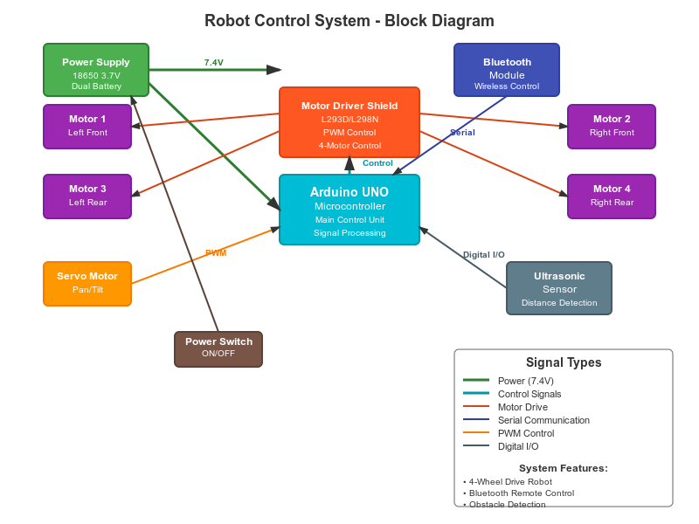
Block Diagram
06

Slide 7
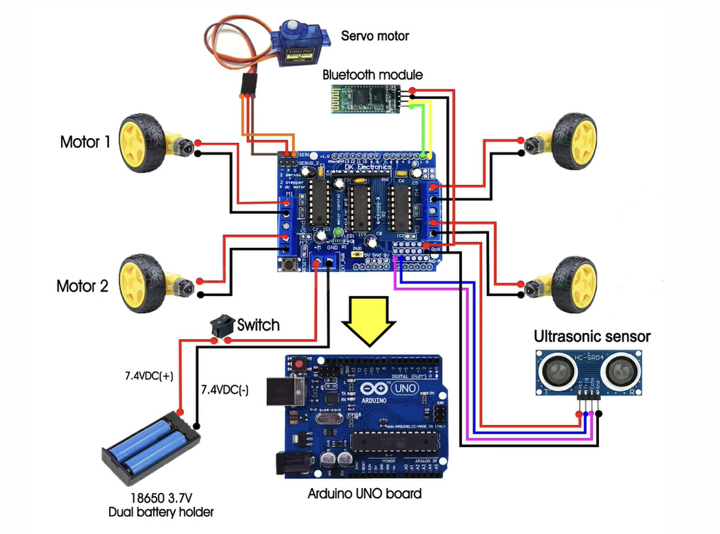
Circuit Diagram
Motor 3
Motor 4
07
https://www.ijsat.org/papers/2025/1/2868.pdf

Slide 8
Expected Outcome
A fully functional multi-mode robot capable of autonomous obstacle avoidance.
Smooth remote control via Bluetooth smartphone app.
Reliable voice command recognition for hands-free operation.
Demonstration of integration between sensors, actuators, and microcontroller.
Enhanced understanding of embedded system design and real-time control.
08

Slide 9

Thank You
09

